Slide 1
The church at Ephesus

Slide 2
REVELATION 1-3
Messages for seven churches then and churches through the ages

Slide 3
Address
Jesus’ Identity
Commendation
Rebuke (not Smyrna & Philadelphia)
Instruction
Warning
Invitation to hear
Promise
7 LETTERS
SIMILAR STRUCTURE

Slide 4
MODERN AKHISAR IS BUILT ON ANCIENT THYATIRA

Slide 5
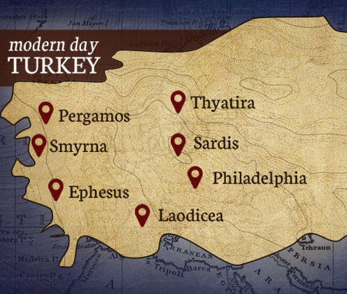
City of Thyatira (Modern Akhisar)
On a plain and vulnerable to conquest
Commercial & military manufacturing
hub during Pax Romana - progress (2:19)
Cosmopolitan population due to many
conquests and economic migration
Many guilds (patron god Appollo Tyrimnaues) for the trades that developed to serve military garrisons
(Modern Akhisar’s city blocks are laid according to trade with goods manufactured sold at the front like Thyatira)

Slide 6
How the Thyatira Church began:
Lydia from Thyatira became a believer in Philippi in Macedonia [ACTS 16:11-15]
May have returned and spread
the message or maybe it was others
impacted by Paul’s ministry.
Began in a syncretistic religious environment.
Local god’s name Helius Pythius Tyrimnaeus Apollo was a composite reflecting Lydian, Macedonian & Hellenic beliefs. Syncretising religions was the natural ancient way of uniting disparate peoples (like now).

Slide 7
UNCOMPROMISING
can be negative or positive
- beligerent – extreme – irreconcilable
- uncooperataive - hard
+ persevering + resolute + determined + steadfast
This message looks at the positive aspects

Slide 8
For: Angel of the Church at Thyatira
From: JESUS – a high picture
Son of God - contra emperor worship
Judge
eyes of fire & feet of brass (2:18)
[local god represented in a bronze statue, so Jesus is depicted as greater than him too]
Jezebel & her children (2:21-23)
All knowing
I know your deeds (2:19)
I am he who searches hearts and minds (2:23)

Slide 9
Good:
I know your deeds, your love and
faith, your service and perseverance,
and that you are now doing more
than you did at first. (2:19)
Bad: toleration of Jezebel who led people into syncretism
Nevertheless, I have this against you: You tolerate that woman Jezebel, who calls herself a prophet. By her teaching she misleads my servants into sexual immorality and the eating of food sacrificed to idols. (2:20)

Slide 10
JEZEBEL (OLD TESTAMENT)
A heathen (1 Kings 16 – 2 Kings 9) who
became Israel's queen then corrupted
God’s chosen people.
JEZEBEL (REVELATION) did the same.
Self-styled prophetess who combined
Christian, Jewish and Pagan elements with magical Judaism and/or Gnostic views (Satan’s so-called deep secrets) while professing Christianity.
May have taught separation of the secular and sacred so that one could swear allegiance to a local god in order to join the trade guild and profess faith in Jesus at the same time.

Slide 11
JEZEBEL
A classic tactic of false prophets is to claim new revelation creating an elite position for themselves and their followers

Slide 12
Warning:
Jezebel and her followers will suffer
and die.
Their sick-bed contrasts the bed
of immorality or the dining couch.
Instruction:
Hold on to what you have, do not follow her - persevere
Invitation to hear & Promise:
Be given authority over the nations and the morning star

Slide 13
PROMISE TO THOSE WHO OVERCOME AND PERSEVERE:
authority over the nations
(see Psalm 2:8-9 & Jeremiah 18:1-11)
A picture of the potter destroying
a rejected vessel, familiar to them
morning star
- could refer to a star on a ruler’s scepter or mean Jesus himself

Slide 14
APPLICATION:
Jesus is great
– he is worth following
Jesus knows the truth about us and in his wholehearted love for us wants us to be wholehearted for him.

Slide 15
APPLICATION:
Christians in some parts of the
world are prevented from doing
business because they will not
swear allegiance to a party or because they are not of the dominant religion.
The economic reality of life creates pressure to compromise their faith.

Slide 16
APPLICATION:
Christians in the west are asked to
compromise on Jesus being the only
way for the sake of social cohesion,
like cultures of the ancient world
Our challenge is
* to keep believing in Jesus as the only way against the tide * to proclaim Jesus as the only way despite criticism
and to do both in a winsome way
It is the challenge of living and shining for Jesus Christ despite the pressure of the crowd.

